Slide 1
SOEN 363 Project Demo
- Mohamed Saidi (40248103)
- Miskat Mahmud (40250110)
- Beaudelaire Tsoungui Nzodoumkouo (40216598)
- Abdel-Rahman Khalifa (40253332)

Slide 2

What did we work on? Books!!
Why? Books are the greatest way to transmit human knowledge, and we believe that efficiently storing them should be a priority
We chose books for our project because their structured data suited SQL well for the first phase. Later, migrating to NoSQL let us explore flexibility and scalability, highlighting the strengths and trade-offs of both approaches.
Where did the data come from?

Slide 3
Two data sources
OpenLibrary API
OpenArchive API
Our DataSet
Extensive collection of Books
Additional book metadata
600MB Dataset

Slide 4
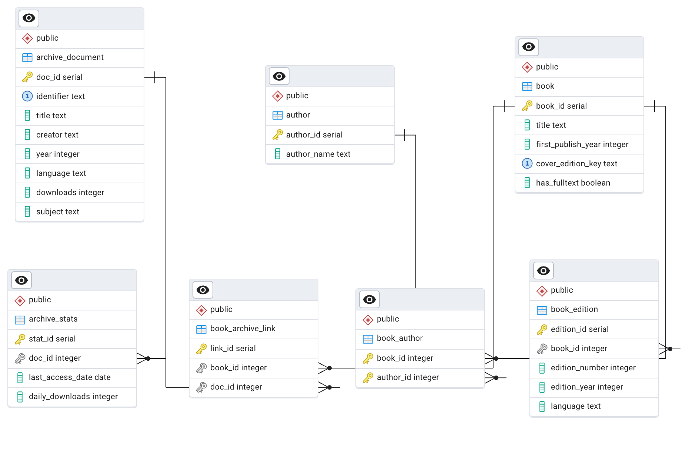
ER Data Model
How do we load that data in our DB?

Slide 5
Data loading (SQL-PostgreSQL)
We use pg8000 as our postgreSQL python client along with PGAdmin for visualisation of the data
Fetch and normalize the data
Pg8000
Run the DDL queries
Insert the data
Where is the code?

Slide 6
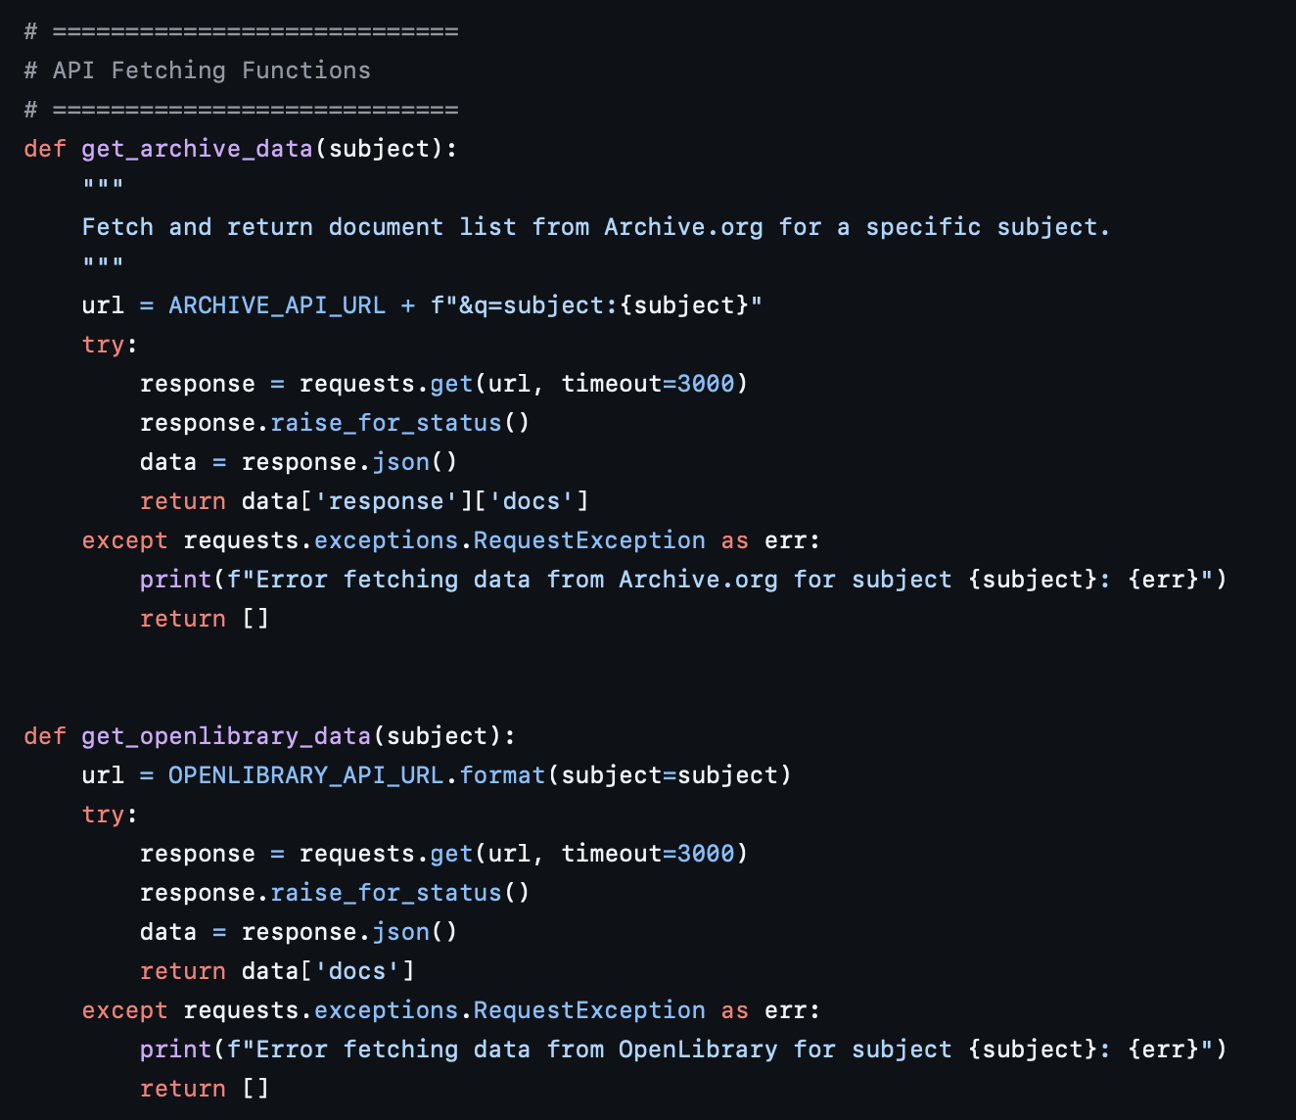
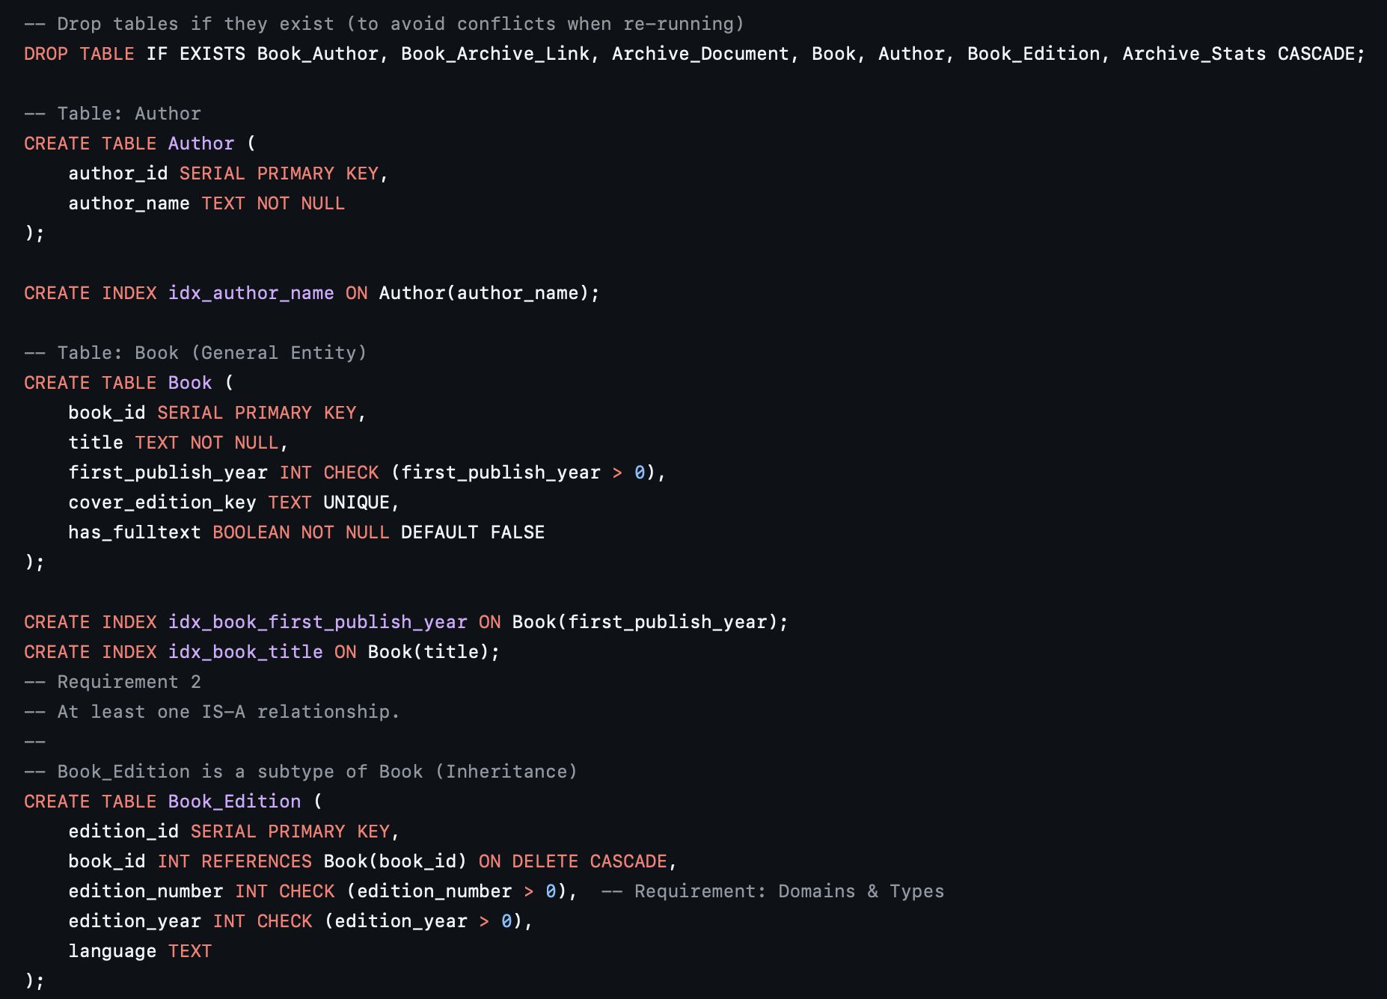
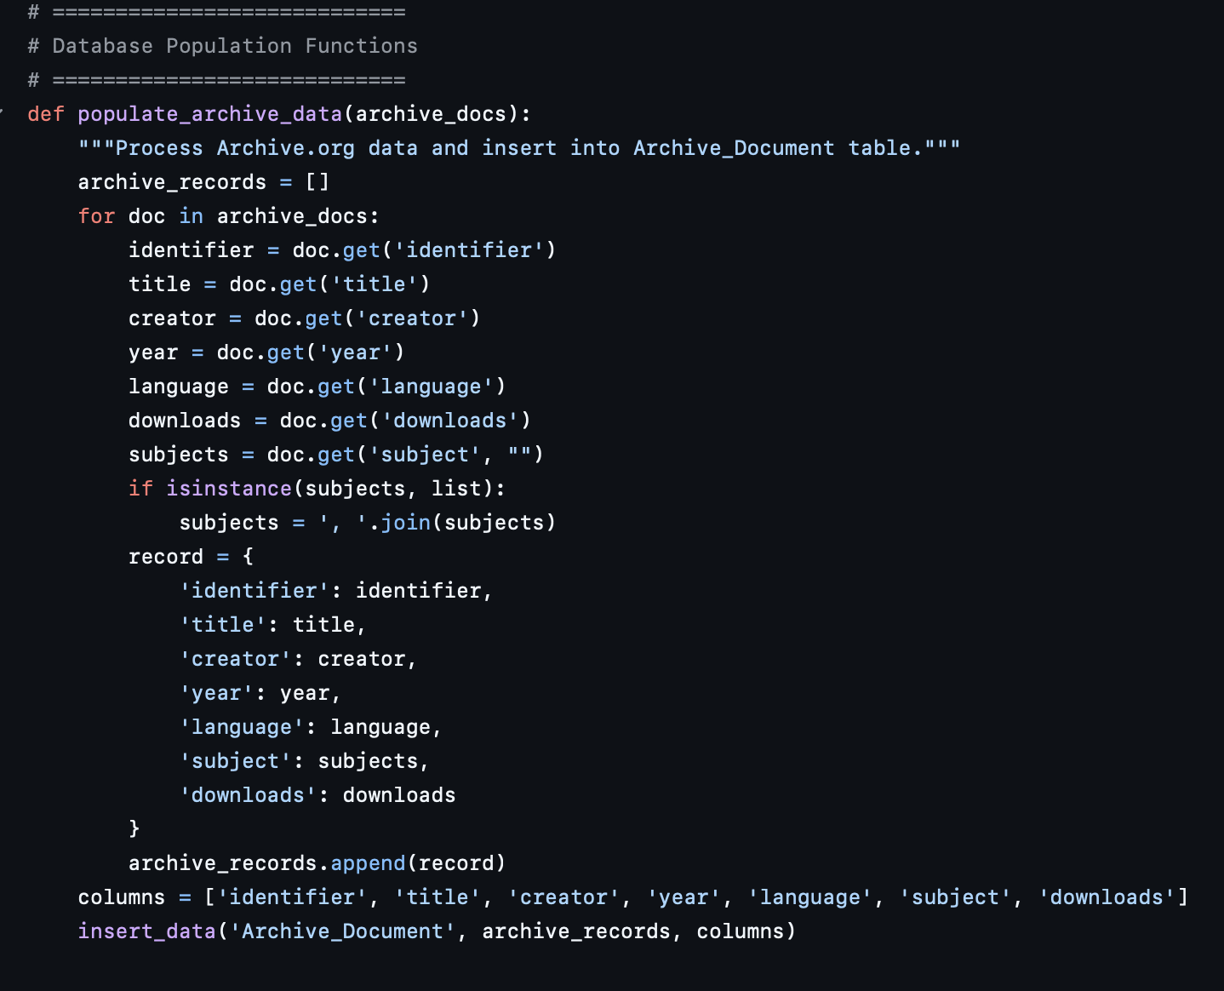
PosgreSQL Data loading
Fetch and normalize the data
Run the DDL queries
Insert the data

Slide 7
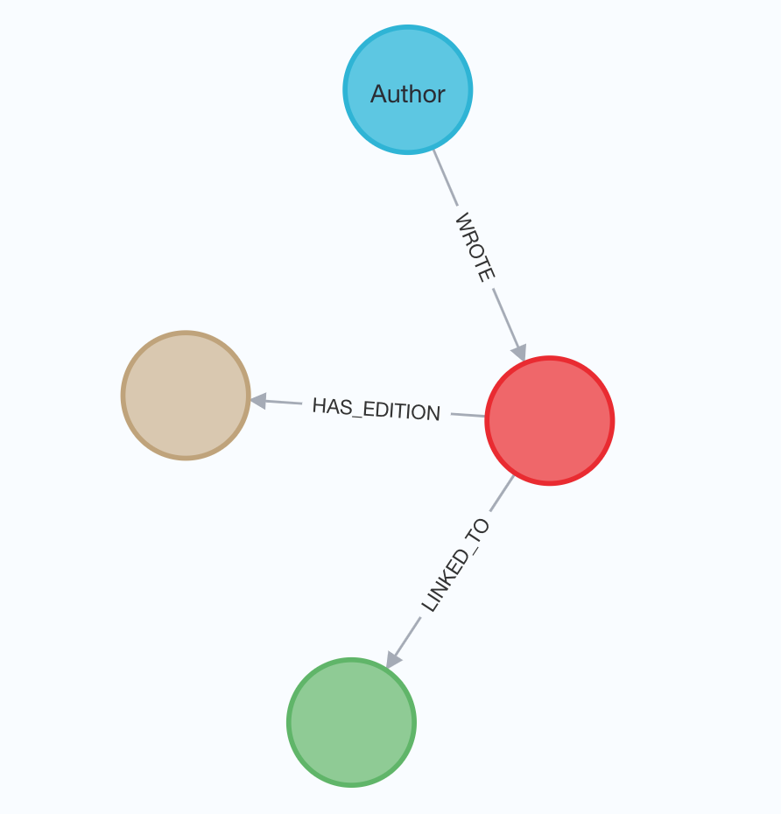
NoSQL (Neo4j) Domain Model
Edition
Book
How did we do the migration
Archive
Document

Slide 8
Migration from SQL to NoSQL
Relational (SQL)
Book → book_author ← Author
Book → book_edition
Book ↔ archive_document via book_archive_link
Graph (NoSQL)
Author —[WROTE]→ Book
Book —[HAS_EDITION]→ Edition
Book —[LINKED_TO]→ Document

Slide 9
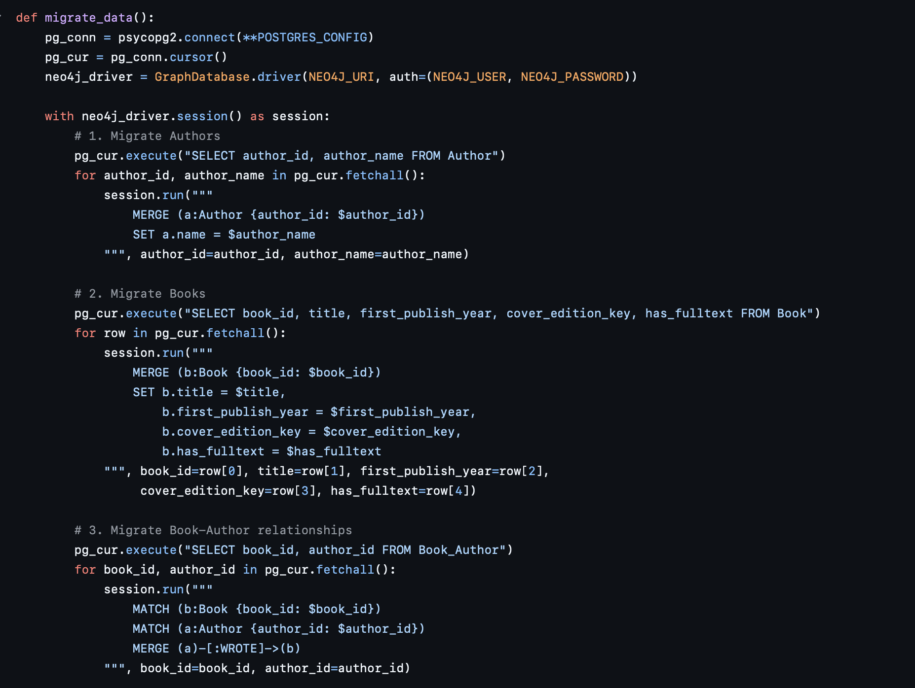
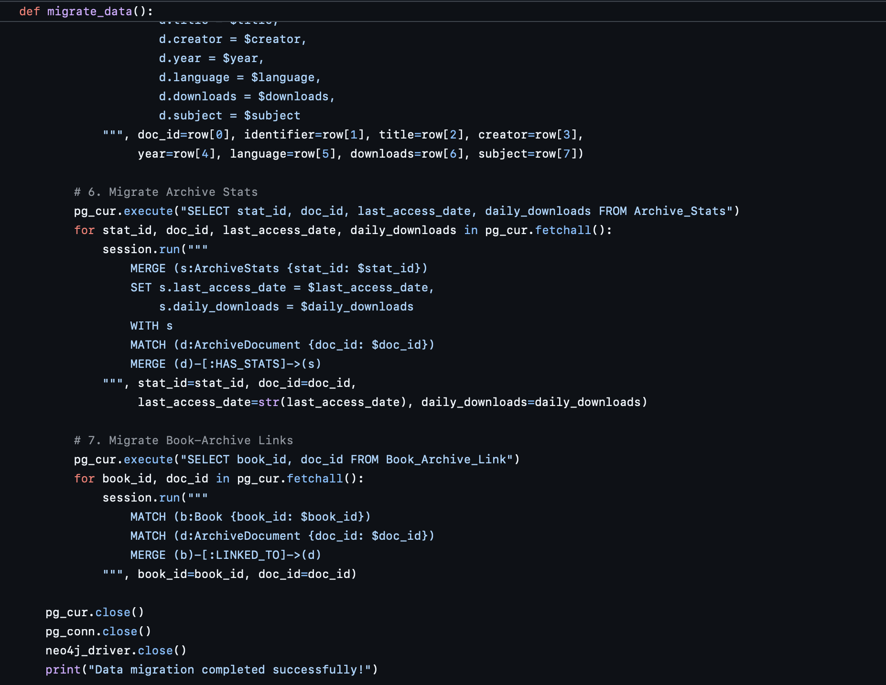
Migration Script

Slide 10
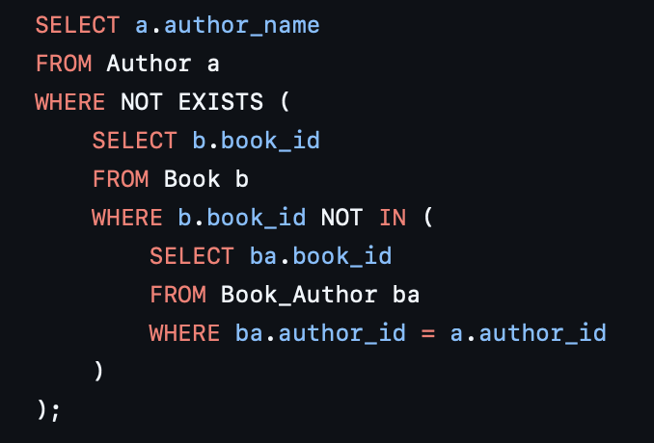
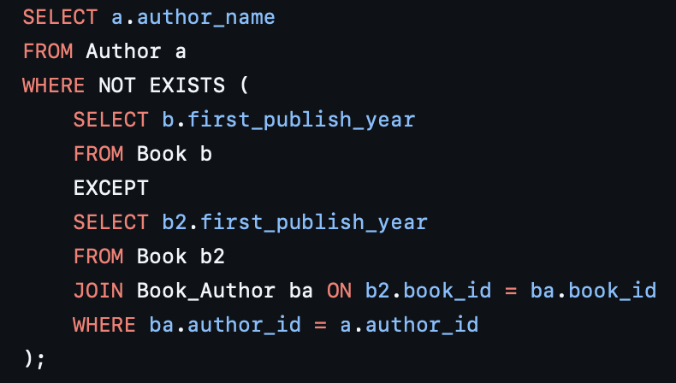
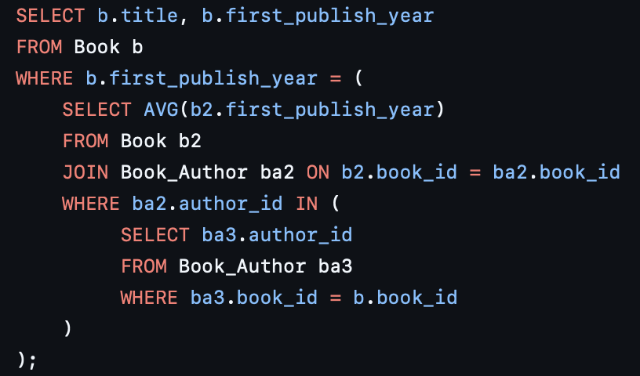
Queries
1
SQL
Find authors who have written every book in the Book table.
Find authors who have written books in every publication year that exists in the Book table.
List books whose publication year equals the average publication year of all books written by at least one of its authors.

Slide 11
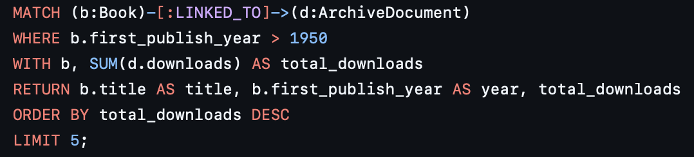
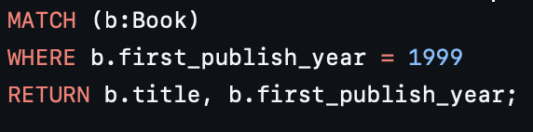
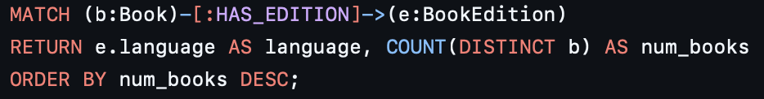
Queries
2
NoSQL
Get top 5 books published after 1950, sorted by downloads of their linked archive documents
Find all books published in 1999
Count number of books grouped by the language of their editions

Slide 12
Availability & Consistency
Neo4J is an ACID system, meaning that the system has high consistency while losing availability.

Slide 13
Availability & Consistency
For a system to have high availability, it will need to adhere to the CAP theorem.
However, the CAP theorem only applies to distributed databases while Neo4J does not allow partitioning or sharding, so it cannot be a distributed database.

Slide 14
Indexes in Neo4j
Discussion
There are 3 types of indexes that we could have in Neo4J:
TEXT Indexes – involve queries that have the keywords CONTAINS, STARTS WITH, AND ENDS WITH
B-TREE Indexes – the default way to search for queries, usually for "normal" queries
TOKEN Indexes – looking up relationships with specific labels

Slide 15
Indexes in Neo4j
Which indexing are we using?
We used B-Tree and Full-Text indexes to significantly improve query performance, reducing DB hits and execution time across both structured and keyword-based searches.
CREATE INDEX book_year_index IF NOT EXISTS FOR (b:Book) ON (b.first_publish_year);
CREATE FULLTEXT INDEX archive_fulltext_fts FOR (d:ArchiveDocument) ON EACH [d.title, d.subject];

Slide 16
Performance
Search for the keyword "history" in title or
subject of archive documents
Evaluate impact of indexing on filtering books by first publish year of 1999
without indexes: 27,604 DB hits, 194 ms
with indexes: 541 DB hits, 112 ms
without indexes: 50,001 DB hits, 643 ms
with indexes: 27 DB hits, 231 ms

Slide 17
References
Slides 12–13: https://www.infoq.com/articles/graph-nosql-neo4j/
Slides 14–15: https://neo4j.com/docs/cypher-manual/current/query-tuning/indexes/
Dataset used: https://archive.org/advancedsearch.php? q=mediatype:texts&fl=identifier,title,creator,year,language,subject,downloads&rows=30000&page=1&output=json
https://openlibrary.org/search.json?q=subject:{subject}&limit=30000

Slide 18
The End

